Slide 1
Customer Churn Prediction
Algorithm Analysis: Random Forest Classifier – A Comprehensive Analysis

Slide 2
1.Introduction to the Algorithm
Algorithm Selected: Random Forest Classifier
What is it?
  An Ensemble Learning method.
  Constructs a "forest" of multiple Decision Trees.
Why Random Forest?
  Robust: Reduces overfitting (unlike single Decision Trees).
  Non-Linear: Captures complex human behavior patterns.
  Explainable: Provides built-in "Feature Importance" scores.
Objective:
  Classify customers as "Churn" (Risk) or "No Churn" (Safe).

Slide 3
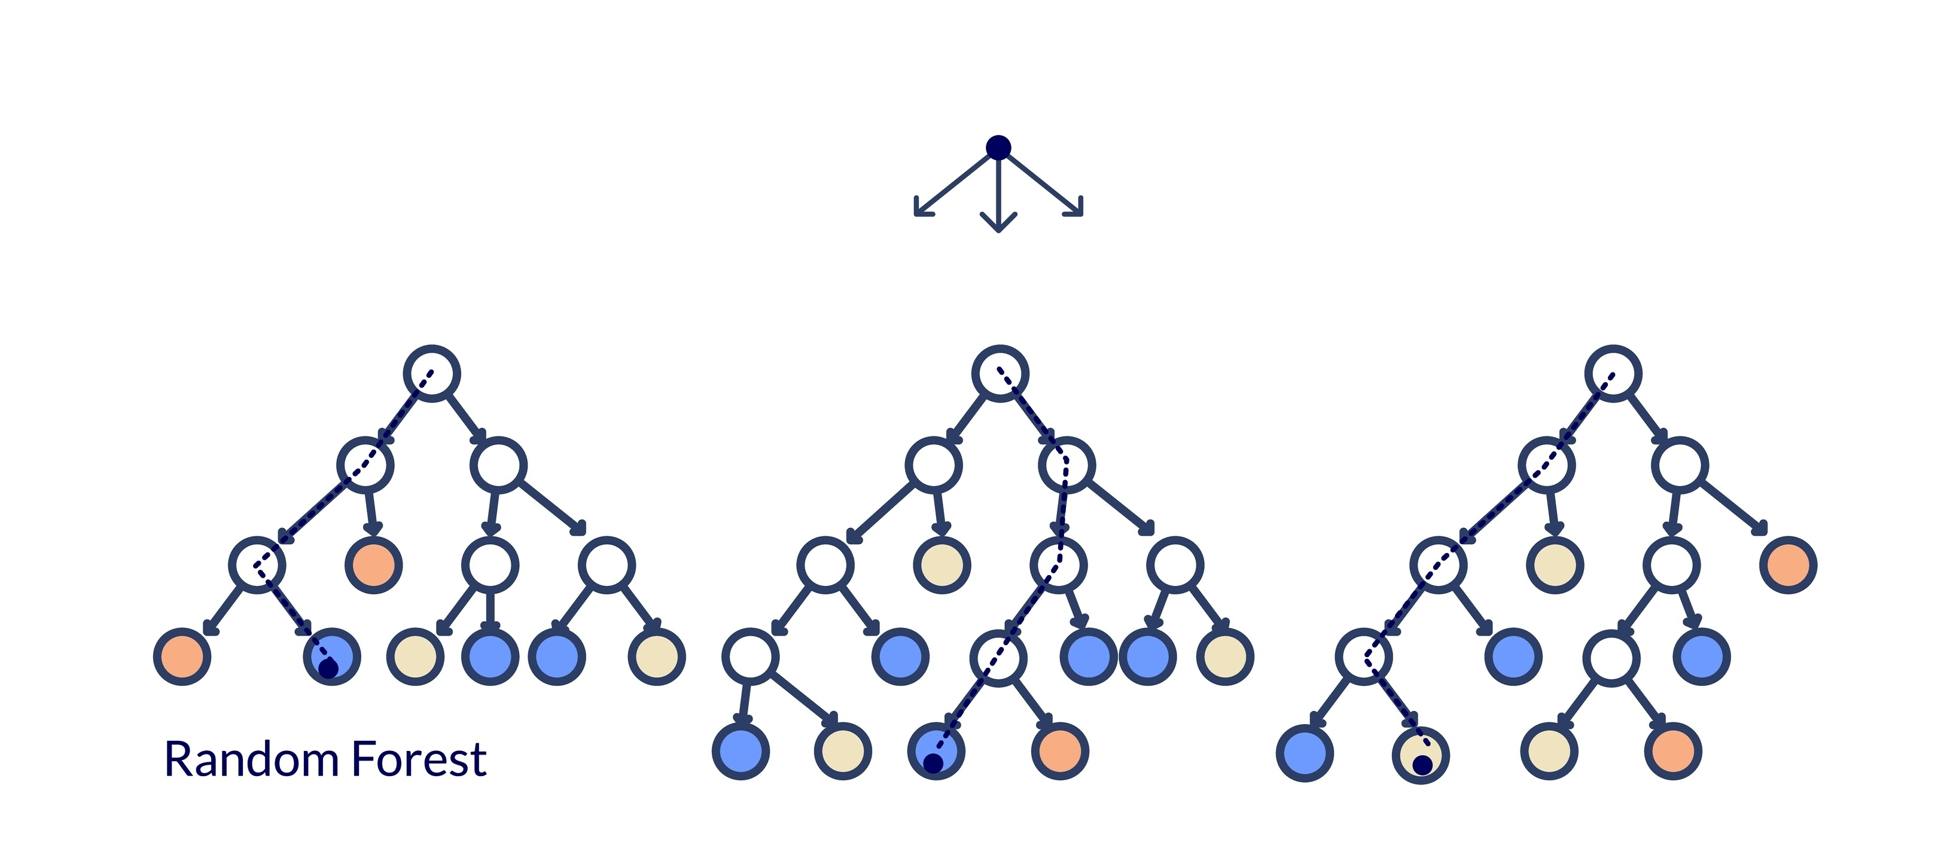
2.Working Principle Concept: Bagging & Majority Voting
1. Bootstrapping (Bagging):
The model creates random subsets of the training data.
Each tree is trained on a different subset (with replacement).
2. Parallel Training:
Hundreds of trees are built independently.
No single tree sees the entire dataset.
3. Aggregation (The "Forest"):
Majority Voting: If 80 trees say "Churn" and 20 say "Stay", the final prediction is Churn.
Benefit: Outliers in one tree are cancelled out by the majority.

Slide 4
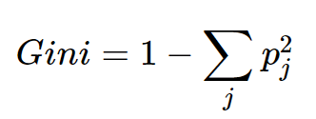
3.Mathematical Intuition
The Split Decision: Gini Impurity
How does a tree decide to split?
  It looks for the feature that best separates the classes (e.g., "Contract Type").
The Metric: Gini Impurity
  Measures the likelihood of incorrect classification of a random element.
  Formula:
Interpretation:
  Gini = 0: Pure Node (All customers are the same).
  Gini = 0.5: Maximum Impurity (50/50 split).
Goal: Minimize Gini Impurity at every split to create the purest possible leaf nodes.

Slide 5
4.Implementation Details (Part 1)
Dataset & Preprocessing Pipeline
Data Source: Telco Customer Churn (7,043 rows, 21 columns).
Key Features:
  Demographics: Senior Citizen, Partner.
  Services: Internet (Fiber/DSL), Tech Support.
  Account: Tenure, Contract, Monthly Charges.
Preprocessing Steps:
  Cleaning: Handled missing values in TotalCharges.
  Encoding: Converted categorical text to numbers (Label Encoding).
  Splitting: 80% Training / 20% Testing.

Slide 6
5.Implementation Details (Part 2)
Handling Class Imbalance
The Problem:
  Real-world data is biased: "No Churn" > "Churn".
  Models tend to ignore the minority class (Churners).
The Solution: SMOTE
  Synthetic Minority Oversampling Technique.
  Creates synthetic examples of Churners by interpolating between existing points.
Result:
  Training set balanced to ~8,200 samples.
  Ensures the model learns to identify Churners effectively.

Slide 7
6.Performance Evaluation
Key Metrics
Accuracy: 0.84%
  Context: Good baseline, but misleading if classes are imbalanced.
ROC-AUC Score: 0.82
  Meaning: Strong ability to distinguish between High-Risk and Low-Risk customers.
Recall (Sensitivity):
  Definition: % of actual Churners correctly caught.
  Why it matters: Missing a churner is expensive. We prioritize Recall over Precision.

Slide 8
7.Confusion Matrix & ROI
Business Impact Analysis
The Results (Test Set):
  True Positives (Caught): 219 Customers.
  False Negatives (Missed): ~150 Customers.
ROI Calculation:
  Scenario: Offer $50 retention discount. CLV = $1,500.
  Savings: 219 caught $\times$ ($1,500 - $50) = $317,550.
  Cost of False Alarms: 160 $\times$ $50 = -$8,000.
Net Benefit: ~$309,550 saved vs. doing nothing.

Slide 9
8.Key Findings
What Drives Churn? (Feature Importance)
Contract Type (Highest Impact):
  Month-to-Month customers are extremely volatile.
Tenure:
  New customers (Months 1–12) are in the "Danger Zone".
  Loyalty stabilizes significantly after 2 years.
Fiber Optic Internet:
  Unexpectedly high churn rate.
  Insight: Indicates potential service quality or pricing issues specific to Fiber users.

Slide 10
9.Conclusions & Recommendations
Strategic Next Steps
Conclusion:
  Random Forest is a profitable tool for retention.
  The model generates $300k+ in potential value per test batch.
Recommendations:
  Adjust Threshold: Lower decision threshold to 0.35 to catch more missed churners.
  Product Fix: Investigate Fiber Optic service complaints immediately.
  Marketing Action: Incentivize Month-to-Month users to move to 1-Year contracts.

Slide 11
Thank You ☺

